Slide 1
Reinforcement Learning for Robot Manipulation Task
Aparajit Venkatesh, Bob Xiaohai Hu
Department of Mechanical Engineering
University of Washington
Dec 5th, 2022

Slide 2
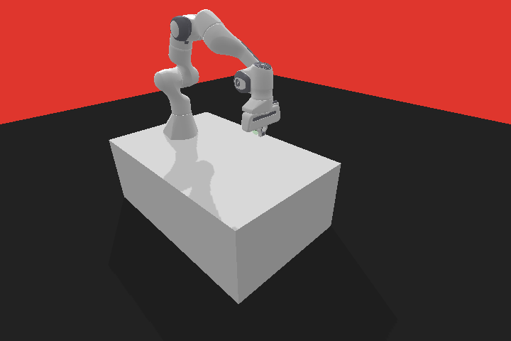
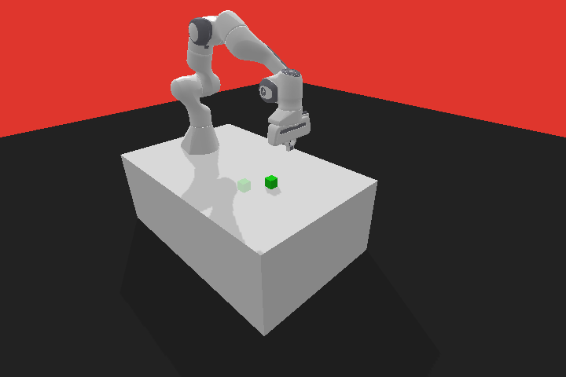

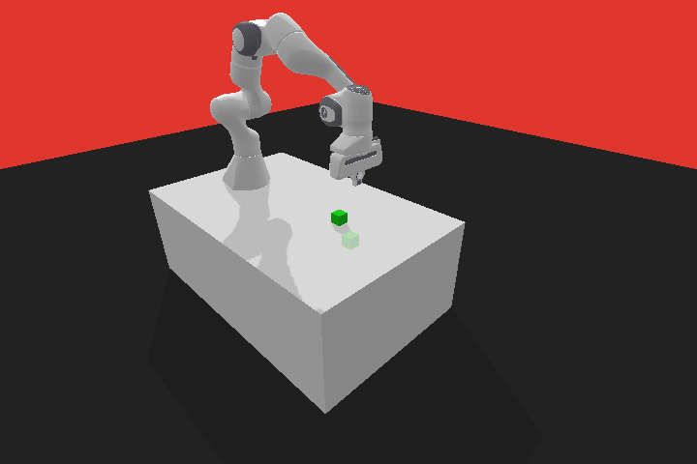

Tasks
Task: Moving gripper/object to a target position
Success if (desired location - current location) < 5cm
Difficulty: Reach < Push < Pick&Place < Stack
Environment Setting
Cube: 4cm x 4cm x 4cm, 0.2kg
Default Lateral friction, Spinning friction
Target / initial position: Randomly generated in a 30 cm × 30 cm square in front of the robot
Action Space: End effector x,y,z and gripper opening
Observation Space: Positions and Velocity of robot and cube (18 coordinates)
Interaction frequency: 25 Hz
Reach
Push
panda-gym
Pick and Place
Stack
Notes:
For our project, we took exploration on applying RL algorithms on four classical tasks in Robotic manipulation, They are Reach, Push, Pick and Place, and Stack
The simulated environment we use is panda gym
A task consists in moving either the gripper or cube to a target position.
And the task is completed when the distance between the entity to move and the target position is less than 5 cm.
These tasks have an increasing level of difficulty. Reach is the easiest, push is a little harder, pick and place is more hard, and stack is the hardiest.
We are using a size of 4 by 4 by 4 cube, it weighs 0.2 kg and we using the default friction coefficient
The target and initial position is randomly generated in a certain square in front of the robot
The action space is the x,y,z coordinate of the end effector and the distance between the parallel gripper
The observation contains the position and speed of the gripper (6 coordinates). Orientation, position, linear and rotational speed of the cube (12 coordinates)
The interaction frequency is thus 25 Hz. An episode is made of 50 interactions

Slide 3
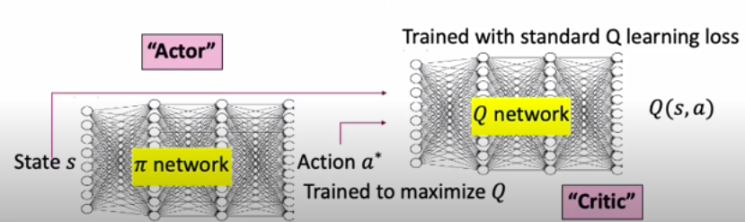
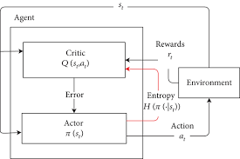
Choice of Algorithms
DDPG(Deep Deterministic Policy Gradient)
Off policy algorithm
DQN for continuous action spaces
Use of policy gradients optimize for Q
Actor network trained to maximize Q
Critic network trained on Q value loss
TD difference from critic used to update actor
SAC(Soft Actor Critic)
Off policy, actor-critic network architecture
Actor aims to maximize expected reward along with maximizing entropy
This approach maximizes reward while maximizing search space
Notes:
The first algorithm we decided to use was Deep Deterministic Policy Gradient. This can be thought of as a Deep Q-Network for continuous action spaces. DQN is great for discrete action spaces, but trying to implement DQN for continuous action spaces, becomes very computationally expensive.Since our action space is continuous, DDPG overcomes this by using policy gradients to optimize for the maximum Q value.
The next algorithm we wanted to use was SAC which was developed by Stanford and Google. This is an off-policy actor-critic algorithm. In SAC, the actor tries to maximize both the expected reward and the entropy of actions. This means that while maximizing the reward, we also come up with a policy that tries to maximize the action space that leads to this reward.

Slide 4
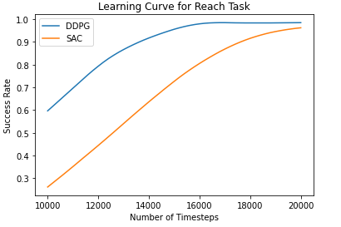
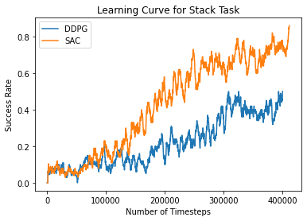
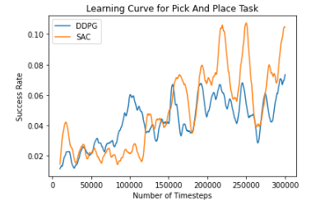
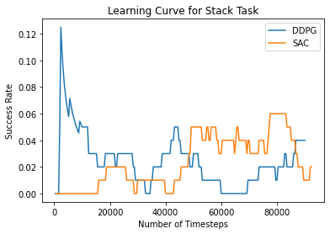
Training Results
Learning Curve for Push Task

Slide 5
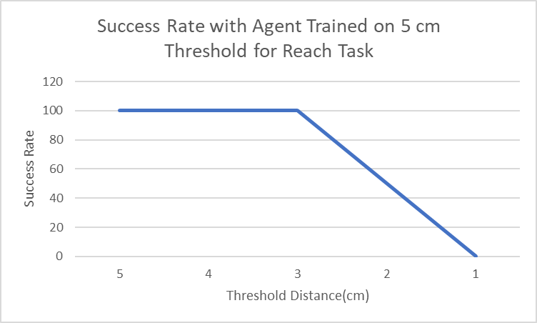
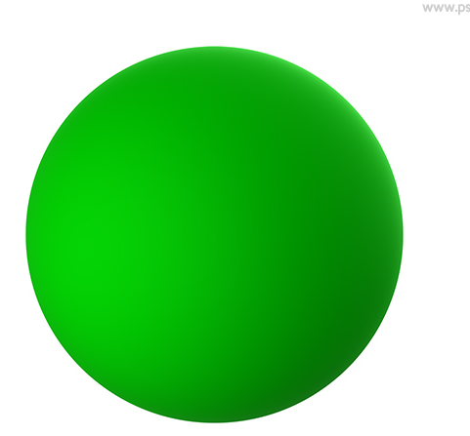
Robustness Reach and Push
Push: Switch from cube to sphere
Success Rate: 50%
Reach: Set a lower threshold
Notes:
So we wanted to explore how robust to change in tasks our trained agents were. So, we used the agent that we trained on the Reach Task with the threshold of 5 cm as the indicator for success, and we reduced this threshold for success all the way to 1 cm. Till a threshold of 3 cm, the agent was able to attain a success rate of 100%, but at 2 cm, it fell to 50% and at 1 cm the success rate was almost 0. Since we had trained on sparse reward, this was very interesting to see that even after reducing the threshold, we were able to achieve success. It is also interesting to see that the agent sometimes oscillates about the goal location trying to get to it and other times the actuation is so less that the agent does not move.

Slide 6
Takeaways and Future Work
Training:
As physics come in to play, convergence takes a lot more training
Very prone to optimal hyperparameter tuning
Robustness:
Trained agents perform reasonably well on slightly modified environments
Agents do not cope well with change in system dynamics
Further exploration:
Performance using dense vs sparse reward function
Control the robot directly with joint values
Different hyperparameters and train longer!!!
Add more to Observation space: Force, tactile sensor
Notes:
So let's take a look at what we learned from this project
For the training part, different from the tetris task, our senaniro interact with the physics, so it take a long time to train, and the hyperparameters have to be very sophisticated set to implement a task
As for the agents robustness, the agents performs well if you slightly modify the environment, but it you change the physics behind, the agents could not handle it well, you should have retrain your model
We also have some thoughts on future work, we could using dense reward instead of sparse reward, cause right now we only penalize whether the task is completed in the current state
We could also control the robot directly with the joint angles, this would allow the agent to learn the inverse robot dynamics by itself
And train longer with different parameters for sure
And last but not least, we could feed more information to the observation space, like the force and tactile information

